Slide 1
On a Generic Uncertainty Model for Position Information
Ralph Lange, Harald Weinschrott, Lars Geiger, André Blessing, Frank Dürr, Kurt Rothermel, Hinrich Schütze
Collaborative Research Center 627 “Nexus” Universität Stuttgart, Germany

Slide 2
Motivation
Importance of position as context information
Variety of application scenarios
Primary context
Position information is subject to uncertainties
Sensing limitations/errors, update protocols, …
Variety of specific uncertainty models
➔ How to process position information from different sources uncertainty-aware?
50%

Slide 3
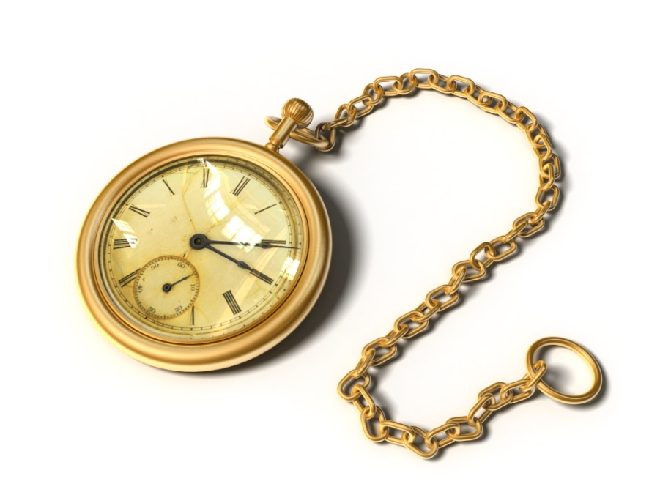
Overview
Problem statement
Survey of specific uncertainty models
Classification
Generic uncertainty model
Generic uncertainty-aware query interface
Implementation
Related Work
Summary
Notes:
Pocket watch from Microsoft Cliparts.

Slide 4
Problem Statement
Extended query interface based on a generic uncertainty model to enable source-independent …
… but uncertainty-aware processing
App1
App2
App3
DB
1. Requirements to generic uncertainty model
Generality, expressiveness, and directness
2. Requirements to extended query interface
Immediacy, comprehensiveness, and generality
Notes:
1. Requirements to uncertainty model
Generality: Applicable to all specific uncertainty models.
Expressiveness: Support for specific models without loss of information.
Directness: Simplicity for implementation with specific inaccuracy models.
2. Requirements to extended query interface
Immediacy: Query interface should immediately build upon uncertainty model to minimize computational effort.
Comprehensive: Query interface should (enable to) exploit all information on uncertainty.
Generality: Query interface should provide prevalent spatial query types such as position query and range query.

Slide 5
Survey of Existing Uncertainty Models
Uncertainty models of positioning technologies
Triangulation and -lateration (e.g., GPS, ultrasonic-based)
Complete pdf, mostly normal distribution
May be estimated by Dilution of Precision (DOP)
Scene analysis (e.g., WiFi, camera-based)
Center point and one or more quantiles
Proximity (e.g., IR-beacons, RFID)
Sensing range given as geometric area depending on setup
50%
90%

Slide 6
Survey of Existing Uncertainty Models (2)
Uncertainty models in update protocols
Dead reckoning and remote trajectory simplification
Trade communication cost off against accuracy
Known and actual position do not deviate by more than accuracy bound ε
Uncertainty models for fusion and interpolation
Bayes filters, possibly based on grid
Fusion with multi-area probabilities
Lense-based interpolation
ε
t₁
v_{max}(t'-t₀)
t'
t₀

Slide 7
Classification of Specific Uncertainty Models
Notation and assumptions
a_{i,t} ∈ ℝ² denotes the actual position of a point-shaped object O_{i} at time t
s_{i,t} denotes the uncertain position at time t
1. pdf-based models
s_{i,t} : ℝ² → [0, ∞)
2. Shape-based models
s_{i,t} = {(A₁,p₁), (A₂,p₂), …}
where A_{i} ⊆ ℝ² and p_{i} ∈ [0,1]
3. Exact model (s_{i,t} = a_{i,t})
Position
Exact/Accurate
Uncertain
pdf-based
Shape-based
Normal
Uniform
…
Circle
Lense
…

Slide 8
Generic Uncertainty Model
All three classes provide probabilistic information
All classes allow for mapping from one or more shapes A ⊆ ℝ² to cumulative probabilities p
s_{i,t}: P(ℝ²) → [0,1], thus s_{i,t}(A) = P[A] = p
➔ Partial spatial distribution function (PSDF)
PSDF even is complete for pdf-based models
Given any shape A_{Q}, the PSDF allows for deriving estimates: 0 ≤ p_{lower} ≤ s_{i,t}(A_{Q}) ≤ p_{upper} ≤ 1
Shape- based
pdf- based
Exact
A_{Q}
10%
50%
30%
10%
Notes:
In bottom right example p_{lower} = 50% and p_{upper}=95%

Slide 9
Uncertainty-aware Query Interface
Approach: Extend query types to account for PSDF-based uncertainties
Prevalent types: position, inside, range, distance, and next-neighbor query
PSDF map from shapes to probabilities
➔ What about the inverse?
Defined point c_{i,t} for object O_{i} at time t
Inherently given with most specific uncertainty models
Unambiguous mapping ĉ_{i,t} : [0,1] → P(ℝ²)
ĉ_{i,t}(p) = A^{C}, circle with minimum radius and center c_{i,t} such that s_{i,t}(A^{C}) ≥ p
50%
80%
10%
c_{i,t}
50%
30%
10%

Slide 10
Uncertainty-aware Query Types
Position query
Expects probability p besides O_{i} and t
Signature: PQ (O_{i}, t, p) → (A, ĉ_{i,t}(p), p_{lower})
… where A := ĉ_{i,t}(p) ⋂ A¹_{i,t} and s_{i,t}(A) ≥ p_{lower} ≥ p
Inside query
Based on three-valued logic derived from two bounds p_{false} < p_{true}
Signature: IQ (O_{i}, t, A_{Q}, p_{true}, p_{false}) → ({true, maybe, false})
Estimates p_{lower} ≤ s_{i,t}(A_{Q}) ≤ p_{upper} to test whether p_{lower} ≥ p_{true} or p_{upper} ≤ p_{false}
Range query by multiple inside queries on set {O₁, …, O_{n}}
A_{Q}
10%
50%
30%
10%

Slide 11
Uncertainty-aware Query Types (2)
Distance query
Based on possible distances between results from position queries
Signature: DQ (O_{i}, O_{j}, t, p) → (d_{min}, d_{max})
Distances between ĉ_{i,t}(p) ⋂ A¹_{i,t} and ĉ_{j,t}(p) ⋂ A¹_{i,t}
Nearest-neighbor query
Based on distance queries
Signature: NNQ (O_{i}, t, p) → (O_{j}, d_{min,j}, d_{max,j})*
Result set contains all O_{j} where min(d_{max,1}, d_{max,2}, …) = δ ≥ d_{min,j}
➔ Set of all possible nearest neighbors with respect to possible positions given by p
d_{min}
d_{max}

Slide 12
Implementing the Query Interface
Exemplary discussion for three prevalent existing uncertainty models
For actual implementations OGC feature types or similar may be used
GPS – completely defined normal distribution function
Position query: Solve for r
Inside query: Integrate pdf over queried range A_{Q}
Interpolation with lenses
Position query: Returns lense-shaped area
Inside query: true if lense completely in A_{Q}; false if completely outside A_{Q}
A_{Q}

Slide 13
Implementing the Query Interface (2)
Grid-based fusion
Uncertain position is set of cells with associated probabilities
Can be stored as 2D table of probability values
Defined point is not directly given
1. Center of most probable cell
2. Centroid
Position query: Circular expansion until probability sum ≥ p
Inside query: Add up probabilities of cells completely inside A_{Q} to p_{lower} … and then add further cells intersecting A_{Q} up to p_{upper}
Return true, false, or maybe depending on whether p_{lower} ≥ p_{true} or p_{upper} ≤ p_{false}
A_{Q}
c_{i,t}

Slide 14
Related Work
Variety of technology-specific uncertainty models for position information
See survey above
Models for uncertain spatial data in general – not only position
Egg-Yolk, fuzzy sets, …
➔ Do not aim at a generic approach integrating existing uncertainty models
Several algorithms for uncertainty-aware processing of spatial queries
Inside, range, and next-neighbor queries allowing for tolerance regions
E.g., MAY/MUST semantics – a special case of p_{lower} and p_{upper}
➔ Compatible with the proposed generic uncertainty model

Slide 15
Summary
Unified approach for uncertainty-aware position information processing
Identified fundamental classes of specific uncertainty models
Generic uncertainty model based on partial spatial distribution functions
Extended query interface for prevalent spatial query types
Expressiveness: Factors in specific uncertainty models very well
➔ … as it just defines an interface to be implemented
But likewise considers possible absence of complete pdf
Next steps: Inside queries with uncertain ranges and objects with extent
ε

Slide 16
Thank you for your attention!
Ralph Lange
Institute of Parallel and Distributed Systems (IPVS) Universität Stuttgart
Universitätsstraße 38 · 70569 Stuttgart · Germany ralph.lange@ipvs.uni-stuttgart.de · www.ipvs.uni-stuttgart.de

